Slide 1
Donor Me
An Application for Managing Blood and Organ Donation in Sri Lanka
Project ID : 2022_311
Supervisor : Ms. Uthpala Samarakoon
Project ID : 2022_311

Slide 2
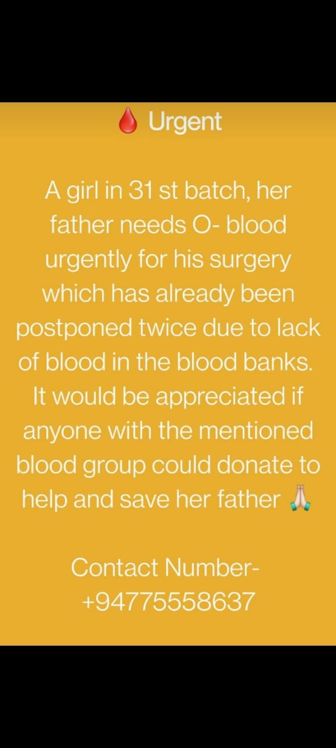
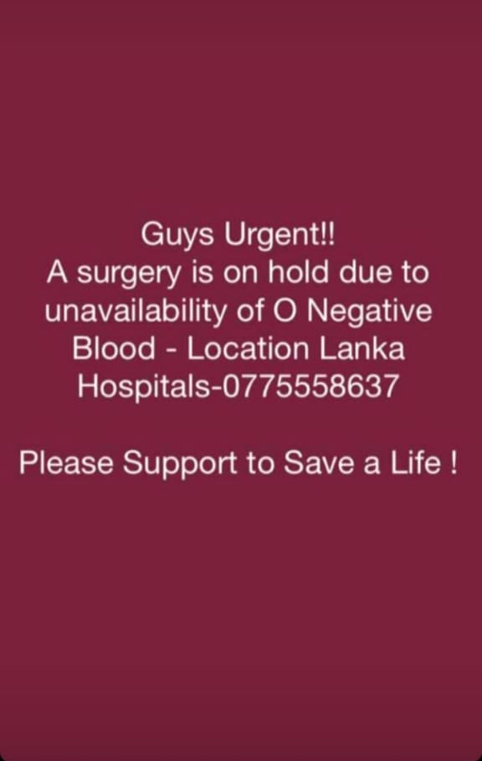
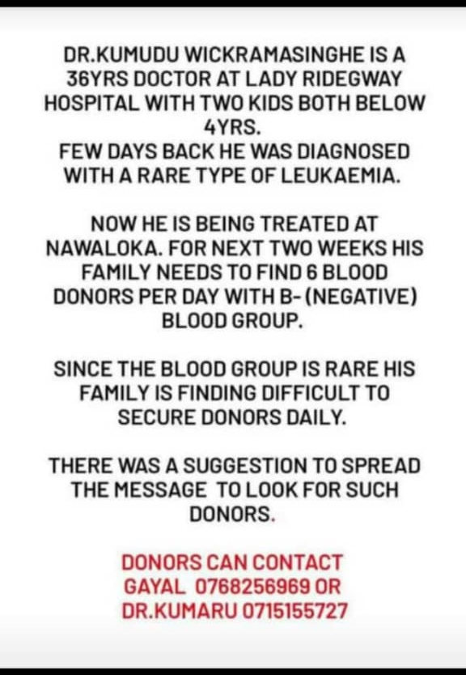
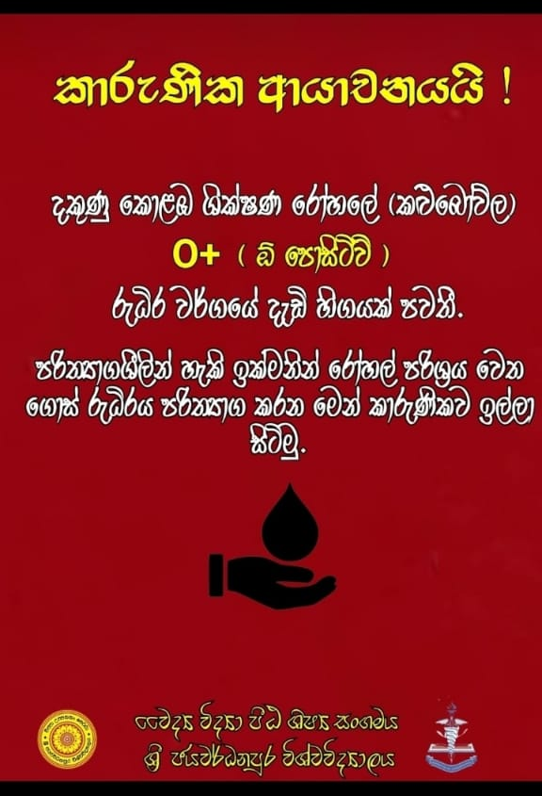
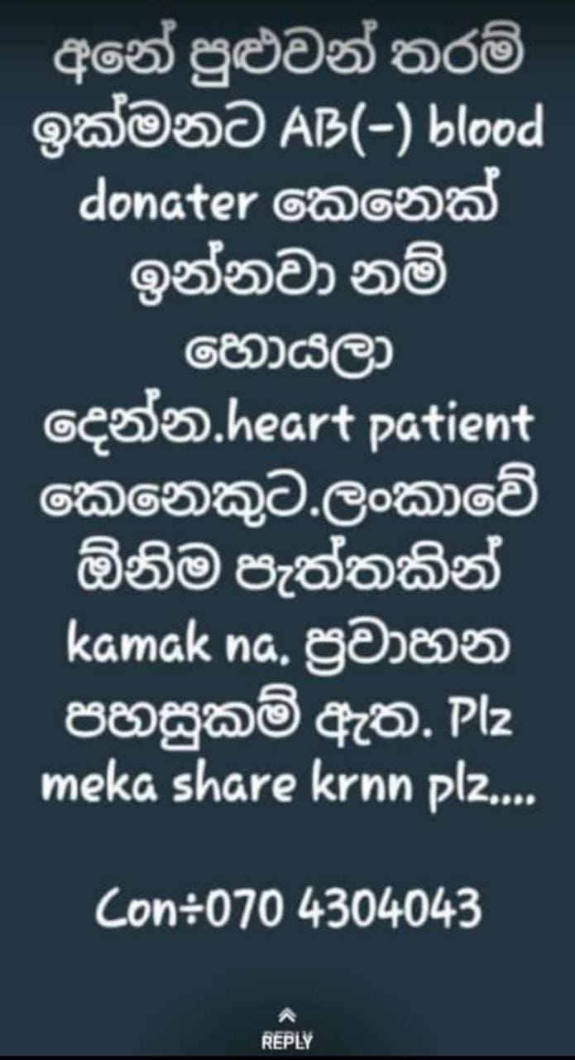

Slide 3
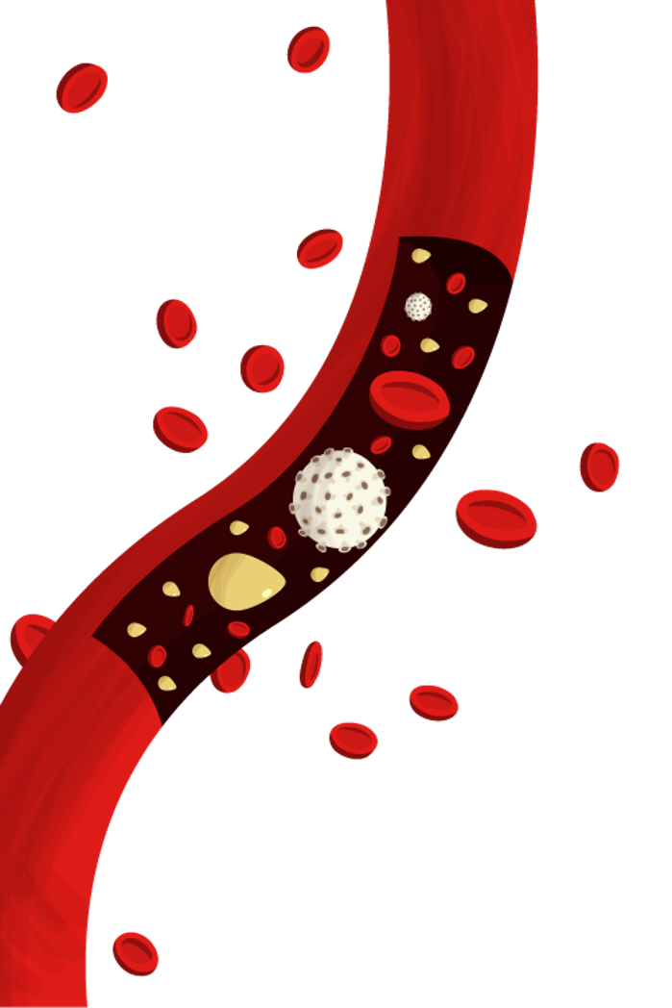
Introduction
In Sri Lanka, all communication between blood and organ donors, banks and recipients are currently done physically with no standardized web or software-based management system
Introducing a software base management system can increase the efficient.

Slide 4
Research Problem
The deficiency of future accessibility of blood and lack of prediction.
How to use an application to reach a larger crowd?
Many medical comparisons are conducted between the donor and the donee in an Orgon transplant, how is this procedure activated through an application?
How to ensure registered donors’ privacy ?

Slide 5
Donor Me ??
Donor me is a mobile application which builds the correspondence in between the donors and the respective donees efficiently by themselves. The Intelligent Blood and Organ Donation System mainly provides solutions for four major issues.

Slide 6
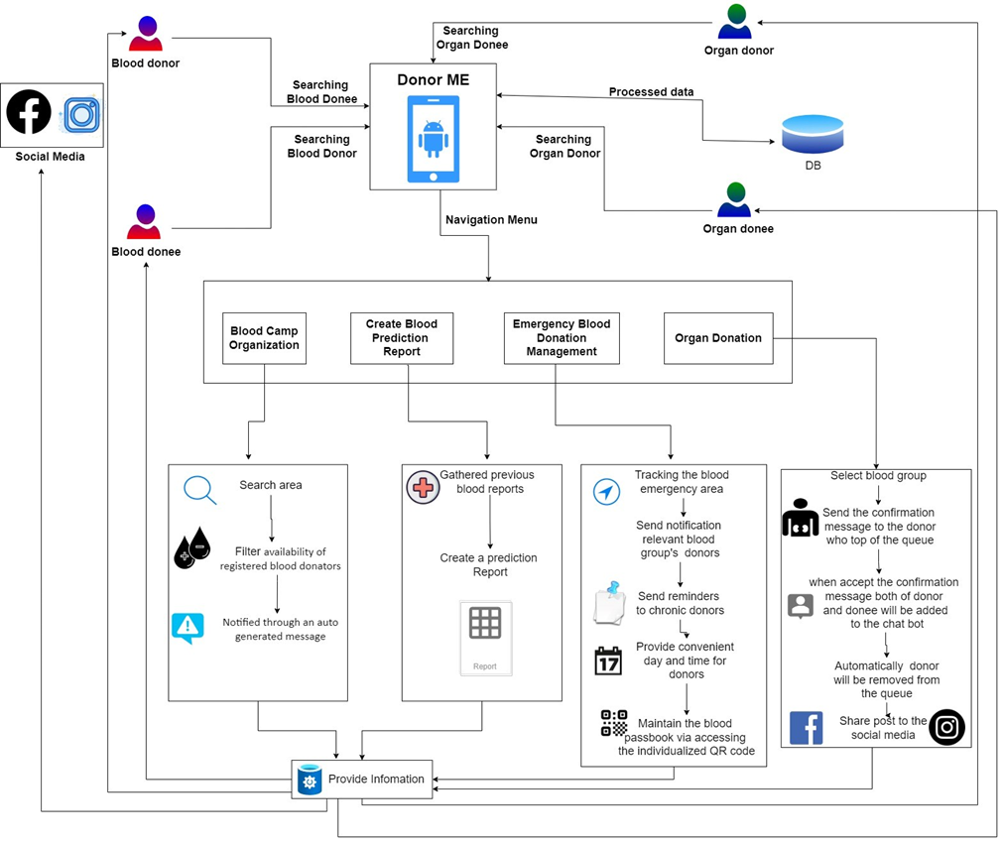
Overall System Diagram

Slide 7
Objectives
The Prediction of blood for the future use
Manage the connection between the organ donors and donees in accordance with their requirements
Select the proper location to hold the blood donation camp
Manage the communication between the blood bank and the donors in accordance with their requirements

Slide 8
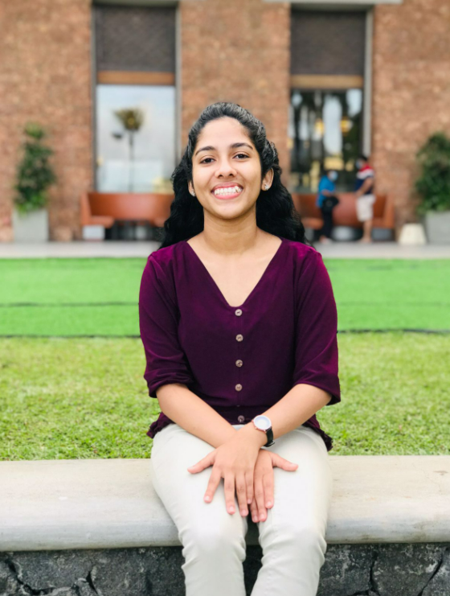

The Prediction of Blood for the future use

Slide 9
Research Questions
Deficiency of future accessibility of blood and lack of prediction?
IT19121734 | R.M.S.Dananjani 2022_311

Slide 10
Specific & Sub Objectives
Specific Objectives
The Prediction of blood for the future use.
Sub Objectives
The amount of Blood needed for each Hospital by the Blood bank is predicted by the System.
In which Times, selected Hospitals need more Blood than Regular months.
For A selected Hospital, the most and least wanted Blood Groups are predicted.
IT19121734 | R.M.S.Dananjani 2022_311

Slide 11
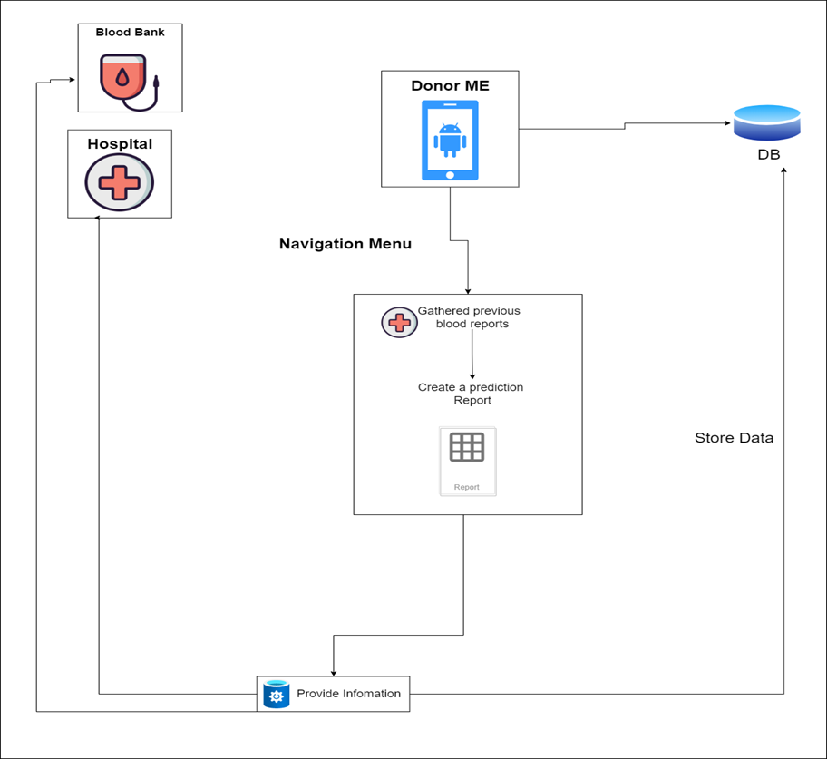
Methodology
IT19121734 | R.M.S.Dananjani 2022_311

Slide 12
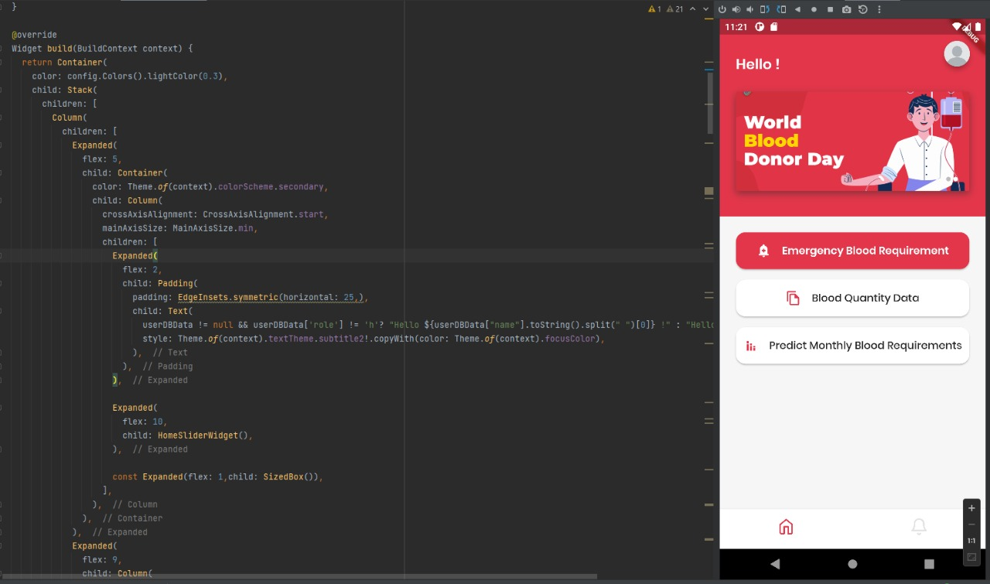
Evidence for the Completion
IT19121734 | R.M.S.Dananjani 2022_311

Slide 13
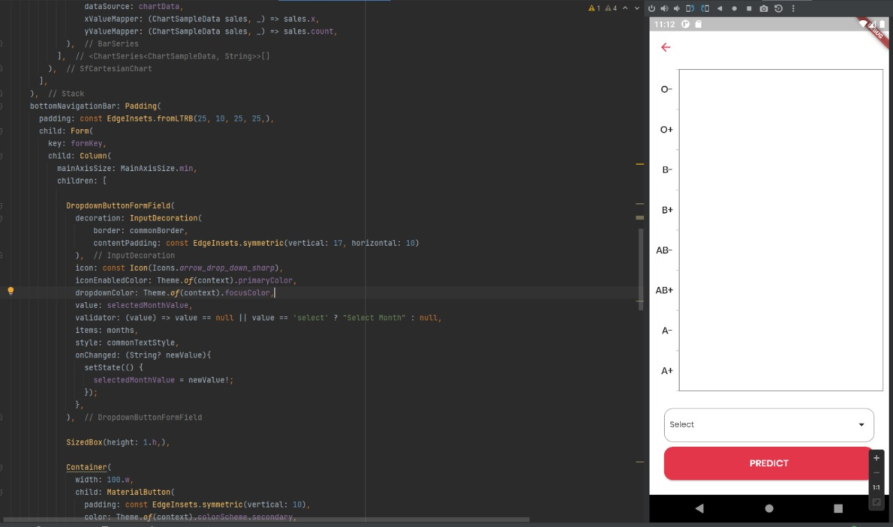
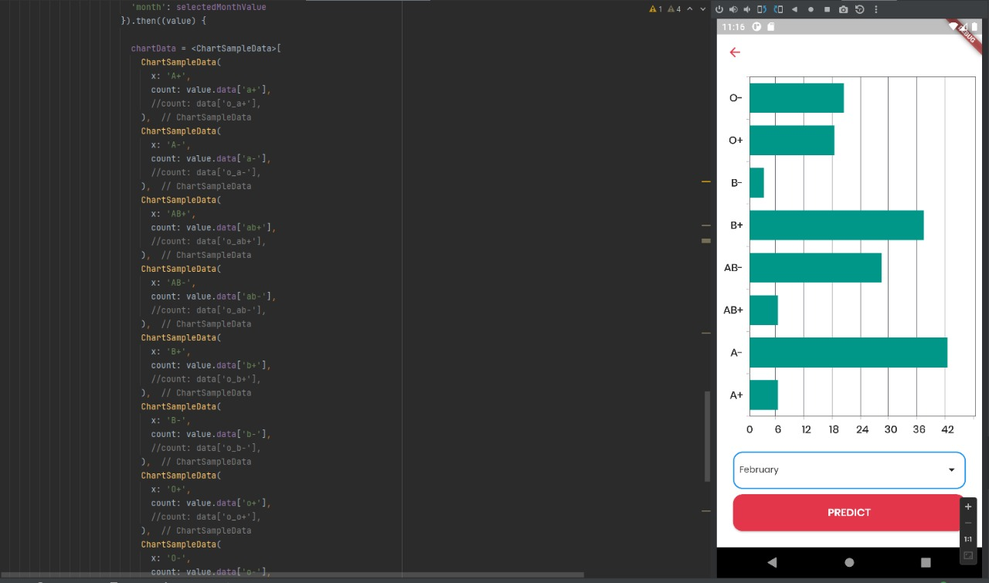
Evidence for the Completion
IT19121734 | R.M.S.Dananjani 2022_311

Slide 14
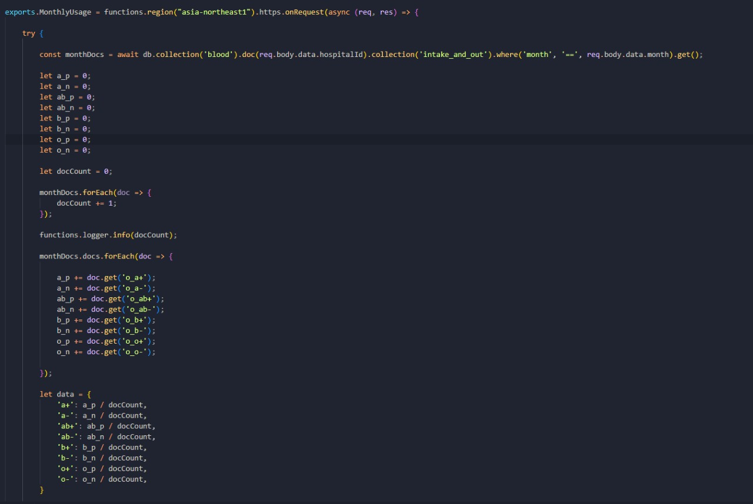
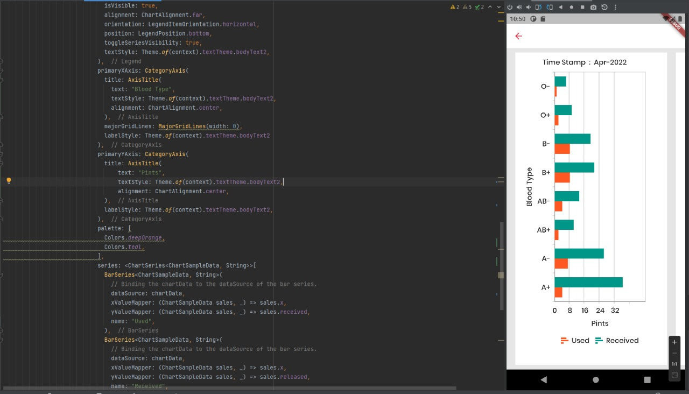
Evidence for the Completion
IT19121734 | R.M.S.Dananjani 2022_311

Slide 15
Completion of the project
60%
40%
Completed Task
Task to Do
IT19121734 | R.M.S.Dananjani 2022_311

Slide 16
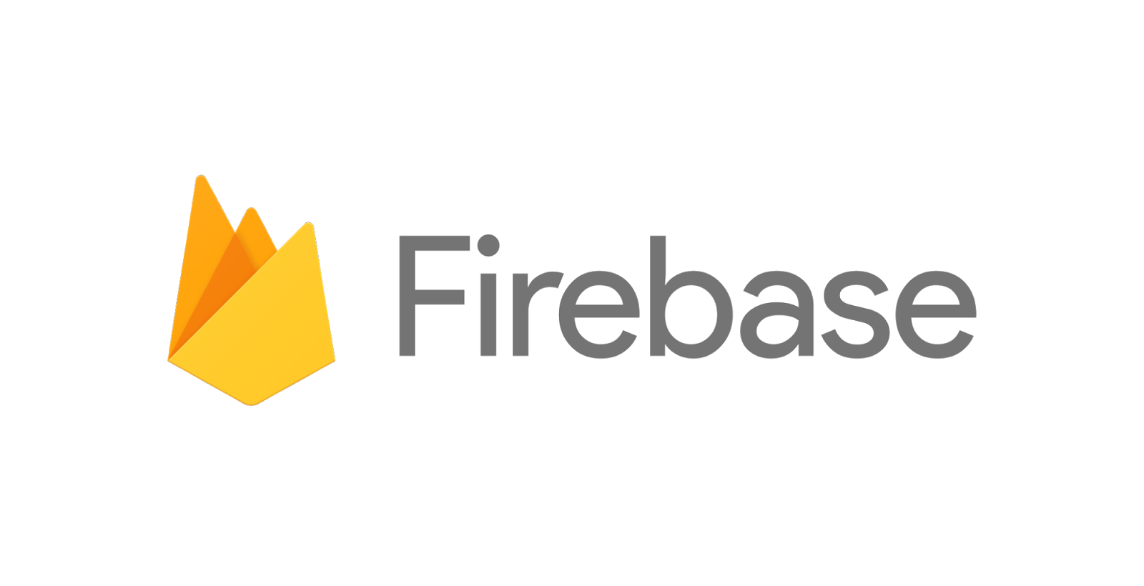


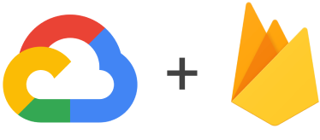
Technologies
IT19121734 | R.M.S.Dananjani 2022_311

Slide 17
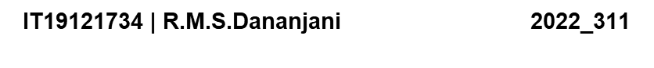
References
[1][. A. R, "Predictors of mortality after discharge in patients hospitalized with heart failure: An analysis from the Organized Program to Initiate Lifesaving Treatment in Hospitalized Patients with Heart Failure (OPTIMIZE-HF)," [Online]. Available: https://www.sciencedirect.com/science/article/abs/pii/S0002870308003232.
[2]A. A. Batis and A. Albarrak, “Preferences and features of a blood donation smartphone app: A multicenter mixed-methods study in Riyadh, Saudi Arabia,” Comput. Methods Programs Biomed. Updat., vol. 1, no. February, p. 100005, 2021, doi: 10.1016/j.cmpbup.2021.100005.
[4] b. A. Azad, "Blood Donation Camp organized by Student Council of BCAS Campus, Kalmunai," 16 August 2018. [Online].

Slide 18
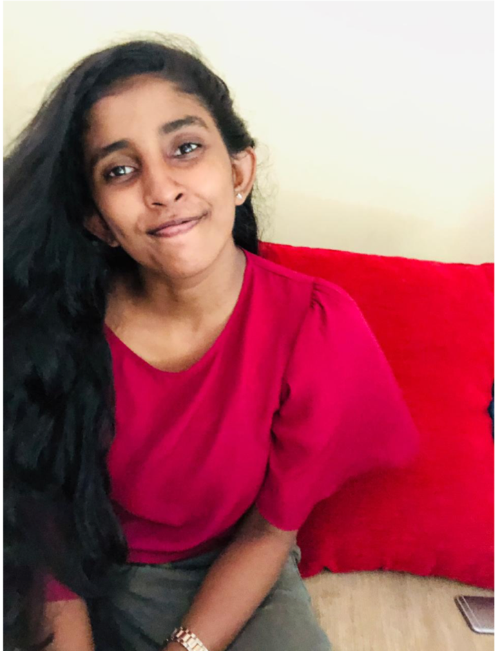
Manage The Blood Donation Camps Effectively

Slide 19
Research Questions
How to locate the nearest blood donation camp ?
How to notified through an auto-generated message the potential donors ?
How to identify suitable location to hold a blood donation camp?
How do we manage to keep donor details confidentially?
How to get information about previous blood camps?
“I need to find a proper location for my blood donation camp”
Abdul , A Blood Donation Organizer
IT19112992 | B N Dullewa 2022_311

Slide 20
Specific & Sub Objectives
Specific Objectives
Select the proper location to hold the blood donation camp
Sub Objectives
Notified donor via auto generate message
Locate the nearest blood donation camp
Show the map to the user via google map
IT19112992 | B N Dullewa 2022_311

Slide 21
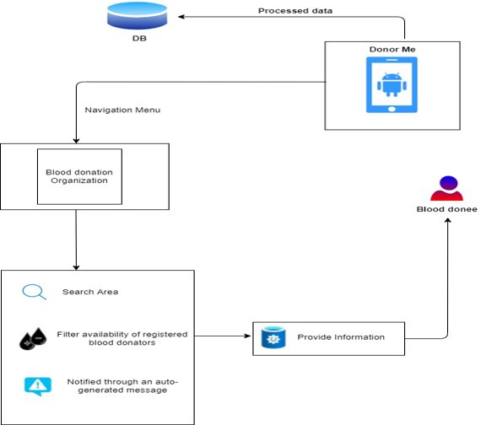
Methodology
IT19112992 | B N Dullewa 2022_311

Slide 22
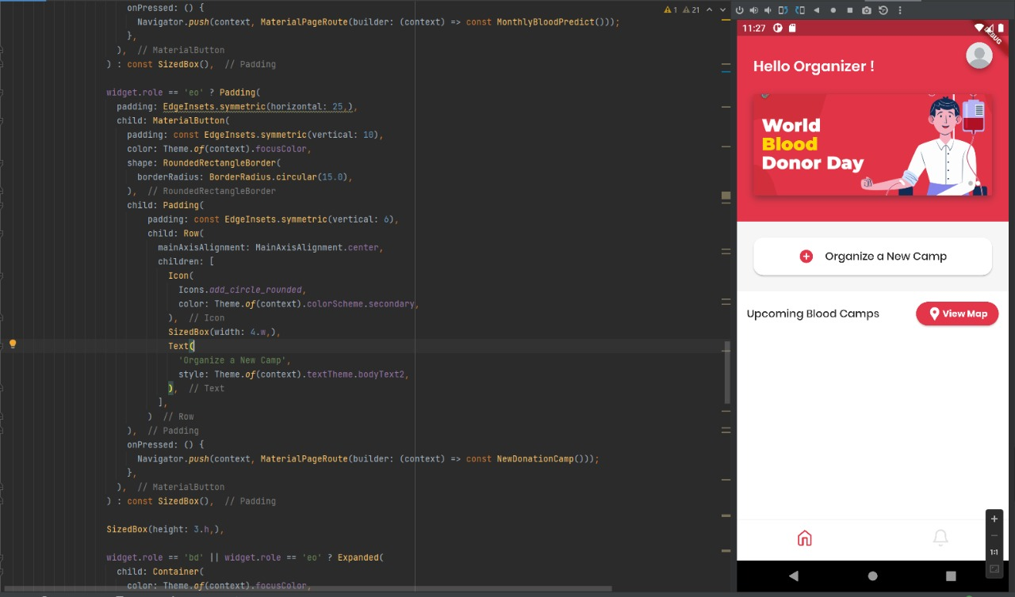
Evidence for the Completion
IT19112992 | B N Dullewa 2022_311

Slide 23
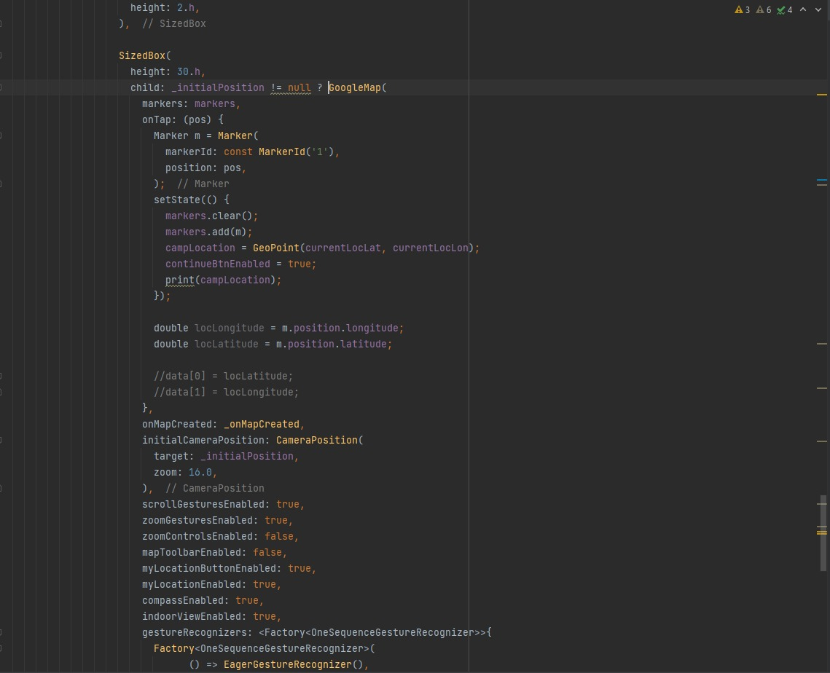
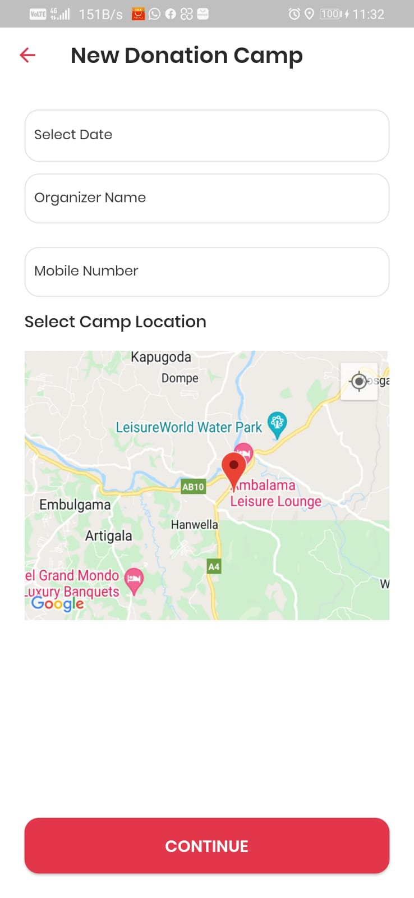
Evidence for the Completion
IT19112992 | B N Dullewa 2022_311

Slide 24
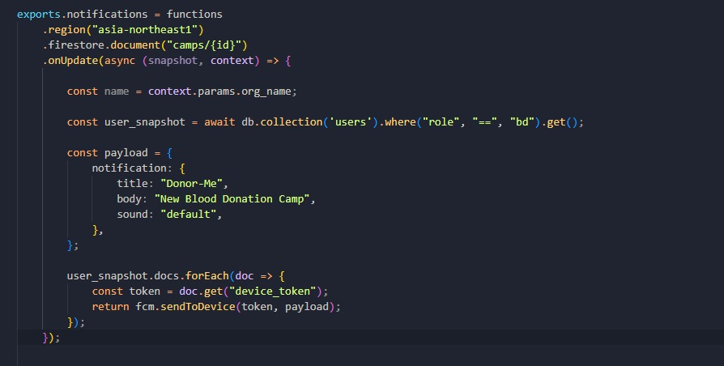
Evidence for the Completion
IT19112992 | B N Dullewa 2022_311

Slide 25
Completion of the project
60%
40%
Completed Task
Task to Do
IT19112992 | B N Dullewa 2022_311

Slide 26
Technologies
IT19112992 | B N Dullewa 2022_311

Slide 27
References
[1][Online]. Available: https://docs.microsoft.com/en-us/analysis-services/data-mining/data-mining-algorithms-analysis-services-data-mining?view=asallproducts-allversions.
[2] "Nation Libaray of medecine," 10 November 2021 . [Online]. Available: https://www.ncbi.nlm.nih.gov/pmc/articles/PMC8687008/.
[3]S. K. R. Nafis Ahmed1, "A guide to organizing a voluntary blood donation camp," [Online]. Available: http://www.ijbti.com/archive/2013-archive/100011IJBTINA2013-ahmed/100011IJBTINA2013-ahmed-full-text.php.
[4] b. A. Azad, "Blood Donation Camp organized by Student Council of BCAS Campus, Kalmunai," 16 August 2018. [Online].
IT19112992 | B.N Dullewa
2022_311

Slide 28
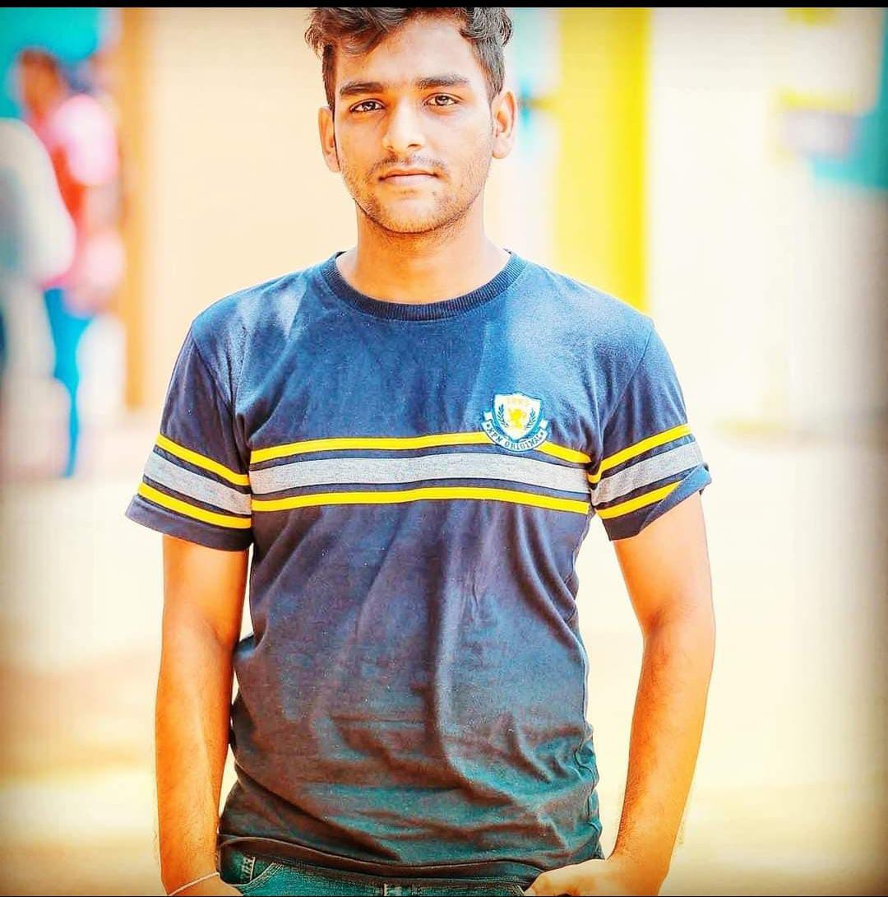
Create A Successful Correspondence In Between The Donors And The Donees​

Slide 29
Research Questions
How do Store Donors in a queue in order of registration? How to Send a confirmation message to the donor? How to create a Chatbot and real-time Message? How to enter the location using google map? How to send notifications to donors and donees?
IT19236438| K.U.R.O.D Bandara
2022_311

Slide 30
Specific & Sub Objectives
*Specific Objectives -Manage the connection between the organ donors and donees in accordance with their requirements *Sub Objectives -Send confirmation messages -create Chatbot and real-time Message -Manage and Send notifications to the registered organ donors and donees
IT19236438| K.U.R.O.D Bandara
2022_311

Slide 31
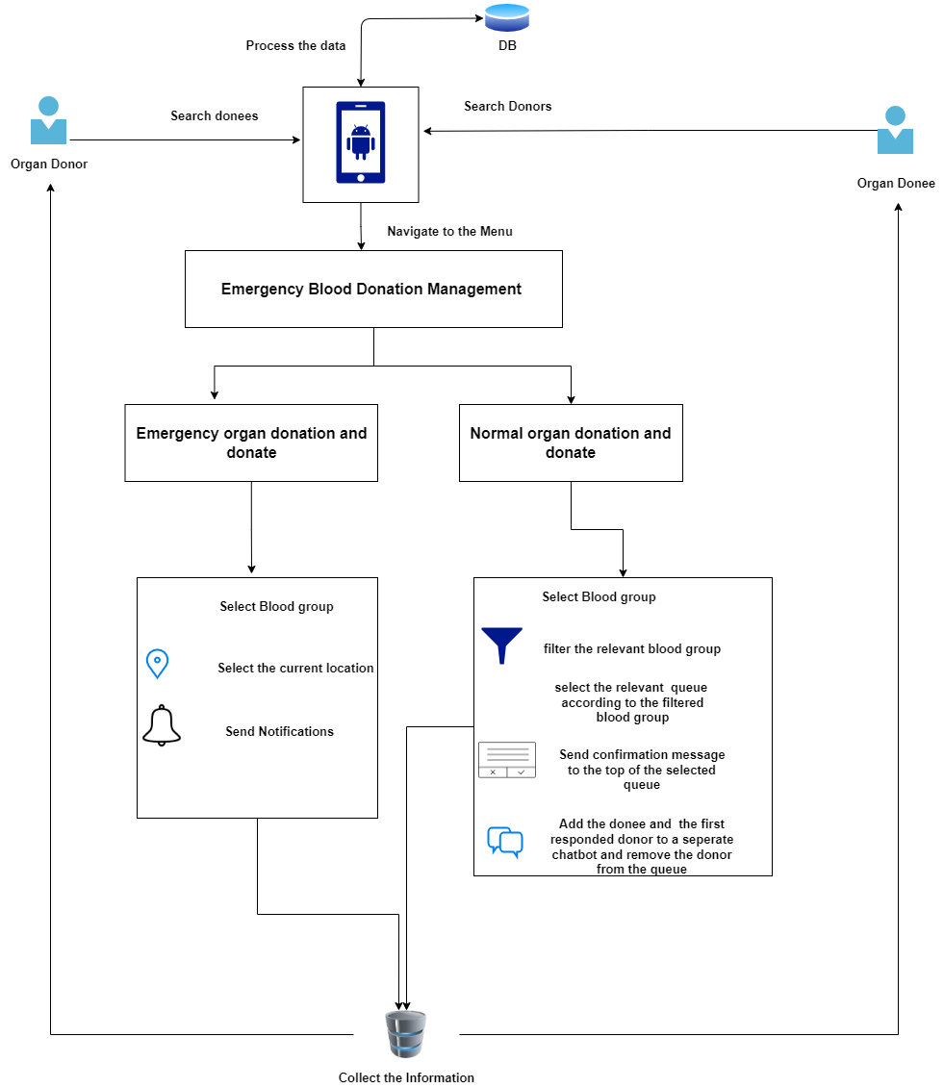
Methodology
IT19236438| K.U.R.O.D Bandara
2022_311

Slide 32
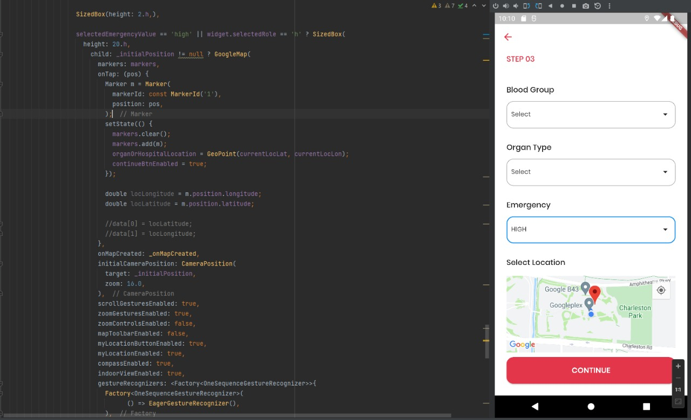
Evidence for the Completion
IT19236438 | K.U.R.O.D Bandara 2022_311

Slide 33
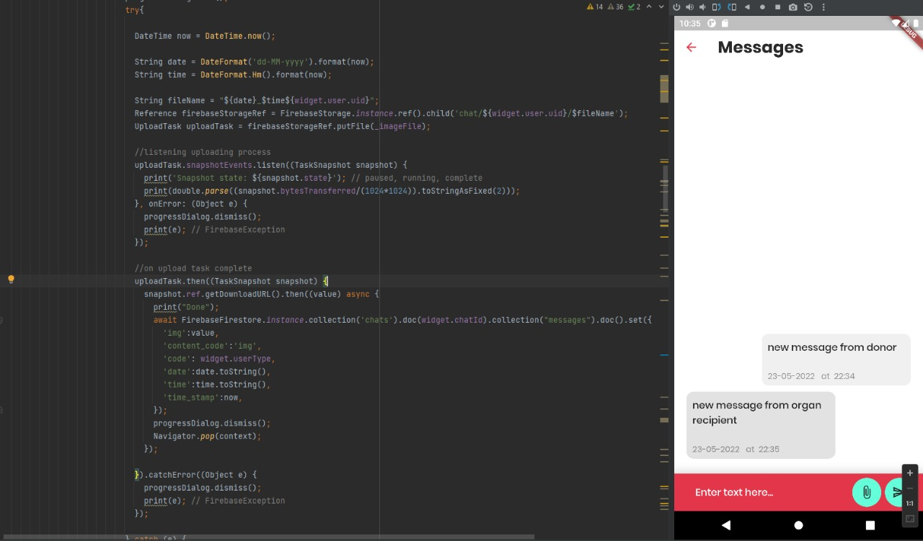
Evidence for the Completion
IT19236438 | K.U.R.O.D Bandara 2022_311

Slide 34
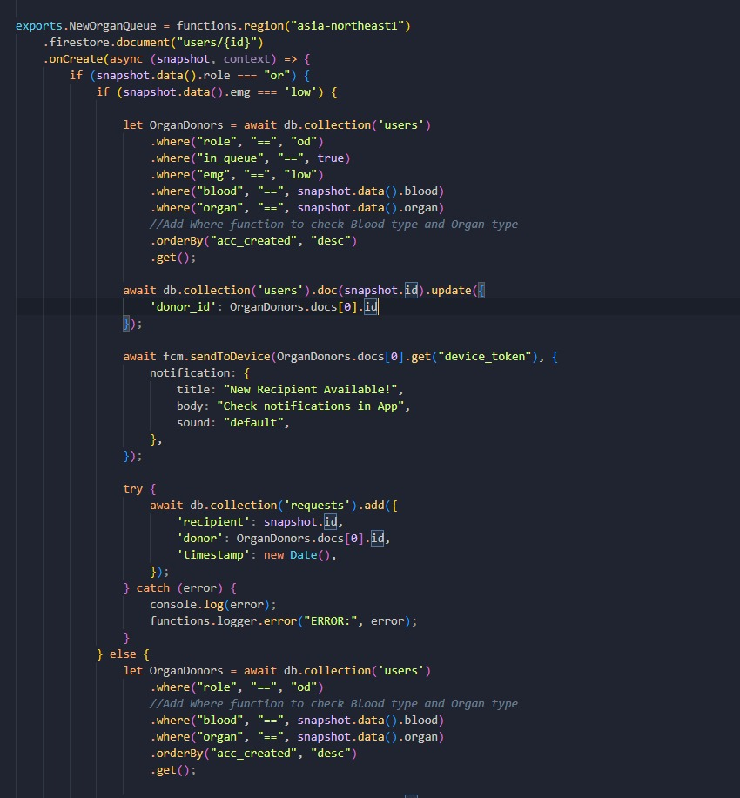
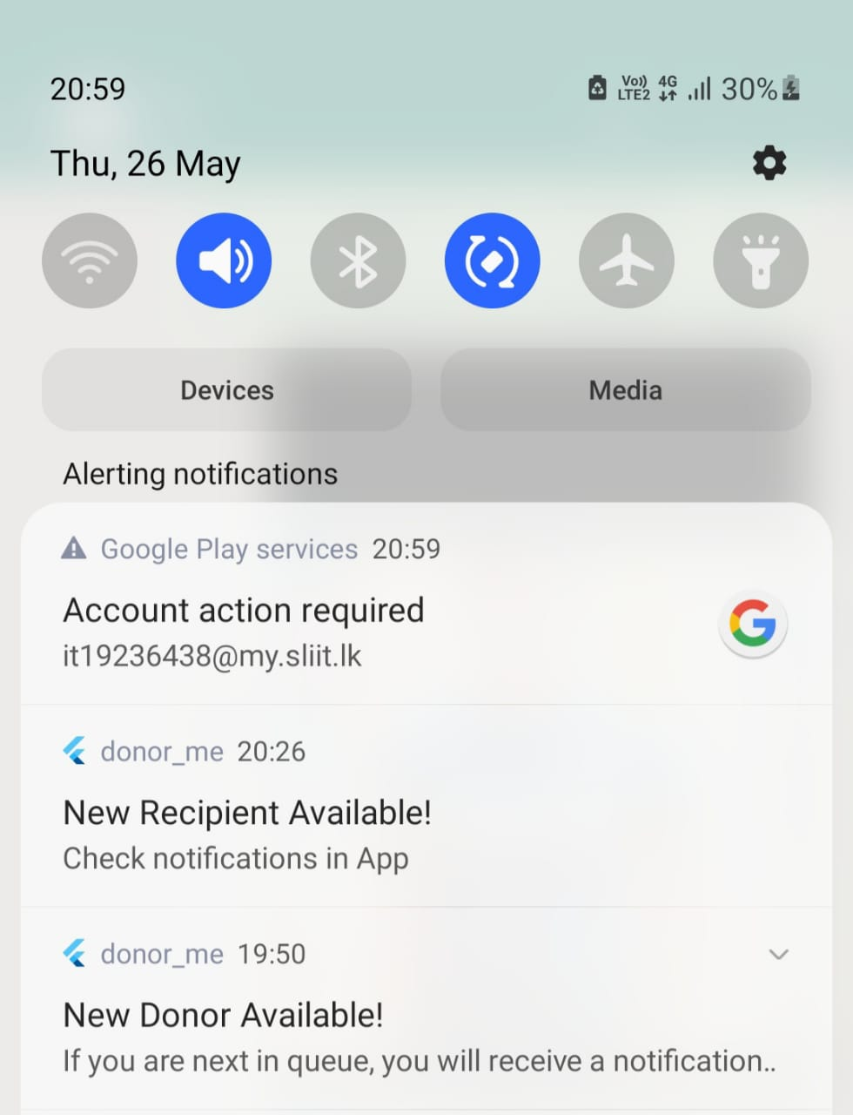
Evidence for the Completion
IT19236438 | K.U.R.O.D Bandara 2022_311

Slide 35
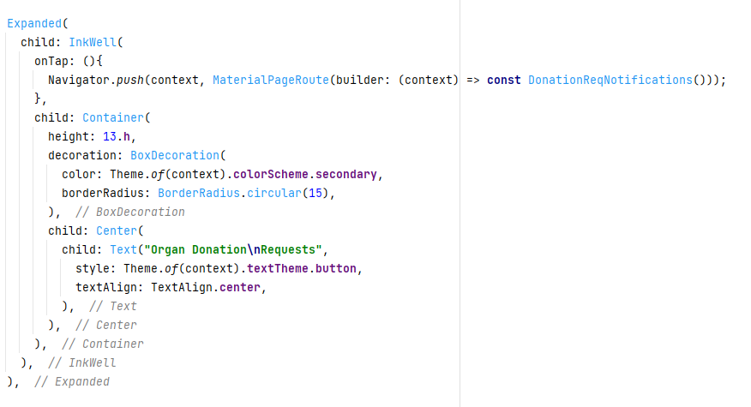
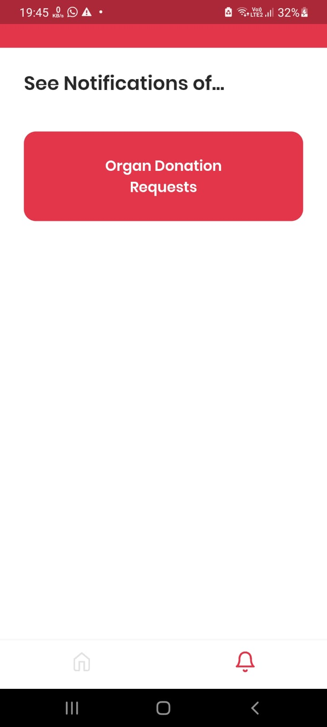
Evidence for the Completion
IT19236438 | K.U.R.O.D Bandara 2022_311

Slide 36
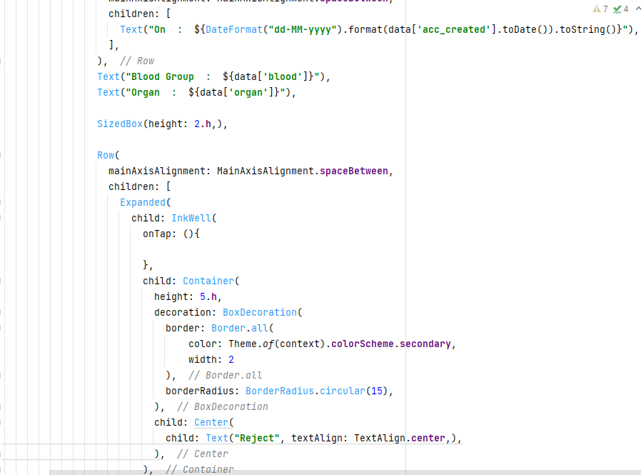
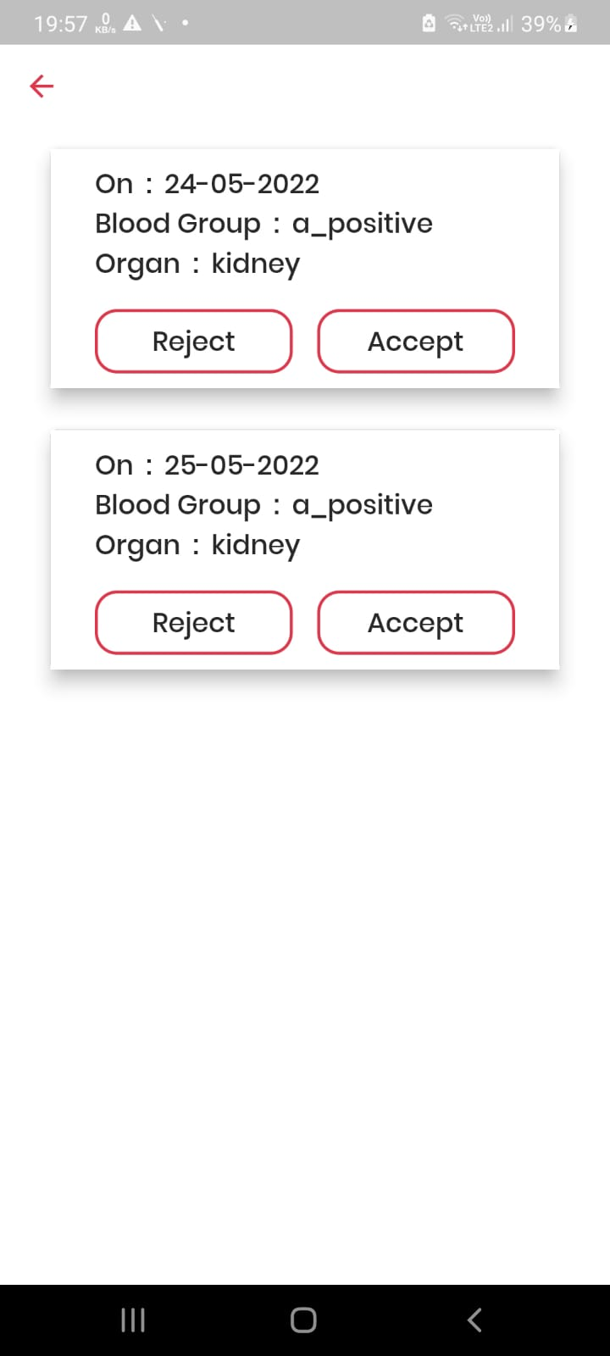
Evidence for the Completion
IT19236438 | K.U.R.O.D Bandara 2022_311

Slide 37
Completion of the project
60%
40%
Completion Of My Sections
Task To Do
IT19236438 | K.U.R.O.D Bandara
2022_311

Slide 38
Technologies
IT19236438 | K.U.R.O.D Bandara
2022_311

Slide 39
References
[1] S. Ouhbi, J. L. Fernández-Alemán, A. Toval, A. Idri, and J. R. Pozo, “Free Blood Donation Mobile Applications,” J. Med. Syst., vol. 39, no. 5, pp. 1–20, 2015, doi: 10.1007/s10916-015-0228-0.
[2]A. A. Batis and A. Albarrak, “Preferences and features of a blood donation smartphone app: A multicenter mixed-methods study in Riyadh, Saudi Arabia,” Comput. Methods Programs Biomed. Updat., vol. 1, no. February, p. 100005, 2021, doi: 10.1016/j.cmpbup.2021.100005.
IT19236438 | K.U.R.O.D Bandara
2022_311

Slide 40
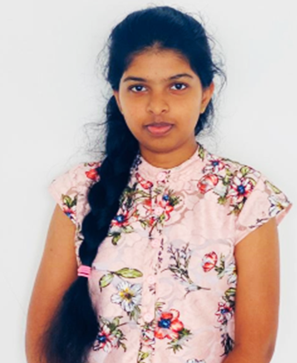
Emergency Blood Donation
Management & Managing Online Passbook
Specialization In Information Technology

Slide 41
Research Questions
How to verify the passbook through the face ID? How to generate QR code? How to send messages by filtering eligible donors? How to tracking donors using google map?
IT19115108 | Malkanthi.P.L
2022_311

Slide 42
Specific & Sub Objectives
Specific Objectives -Manage the communication between the blood bank and the donors in accordance with their requirements Sub Objectives
-Send notifications to the registered eligible donors, by using google map -Provide an online passbook -Verification of the passbook through the face ID -Automatically update the donation records in passbook by scanning the QR code
IT19115108 | Malkanthi.P.L
2022_311

Slide 43
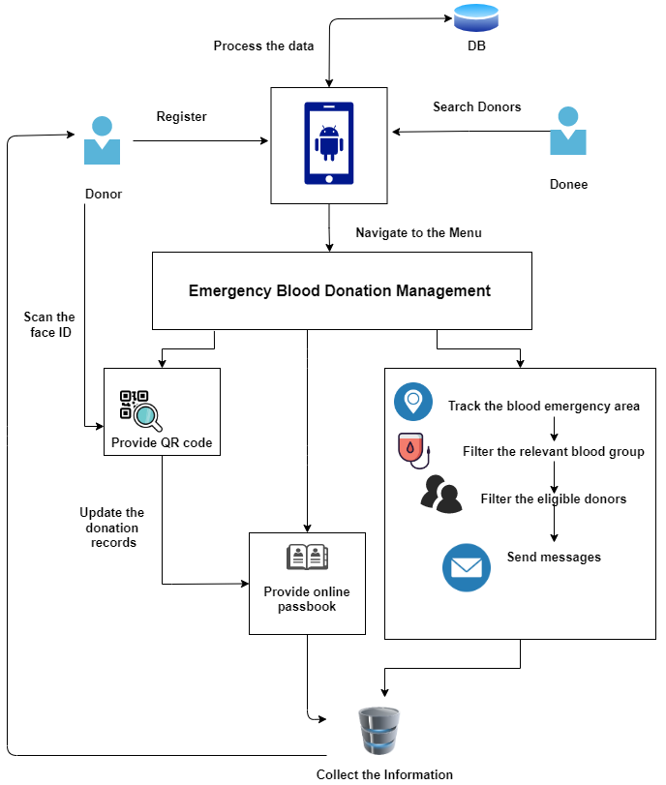
Methodology
IT19115108 | Malkanthi.P.L
2022_311

Slide 44
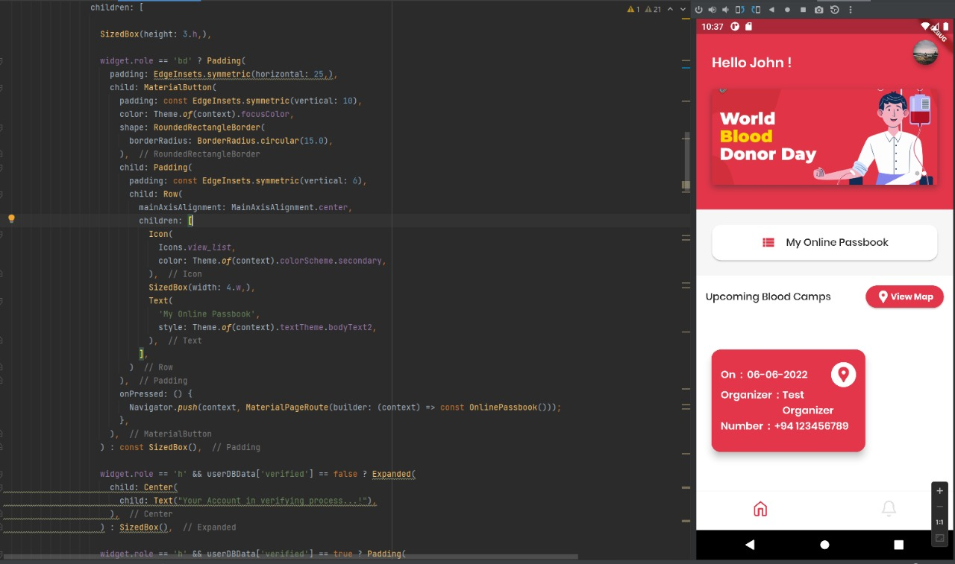
Evidence for the Completion
IT19115108 | Malkanthi.P.L
2022_311

Slide 45
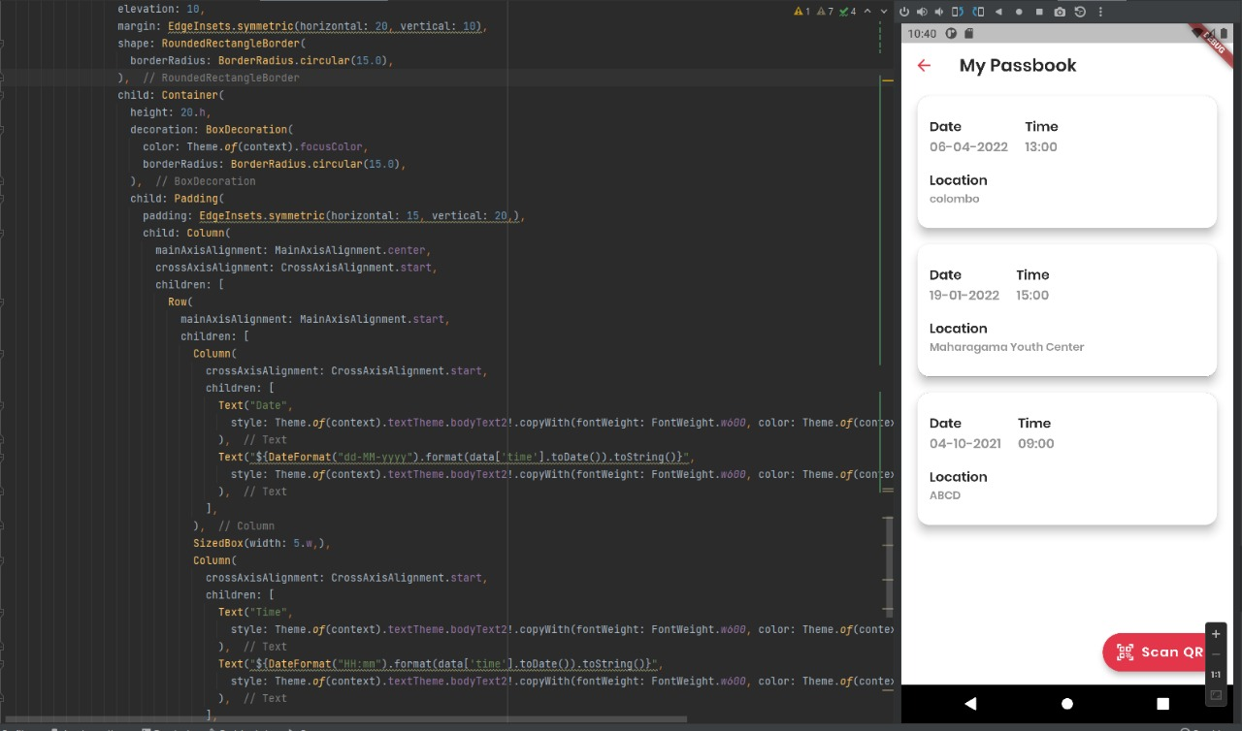
Evidence for the Completion
IT19115108 | Malkanthi.P.L
2022_311

Slide 46
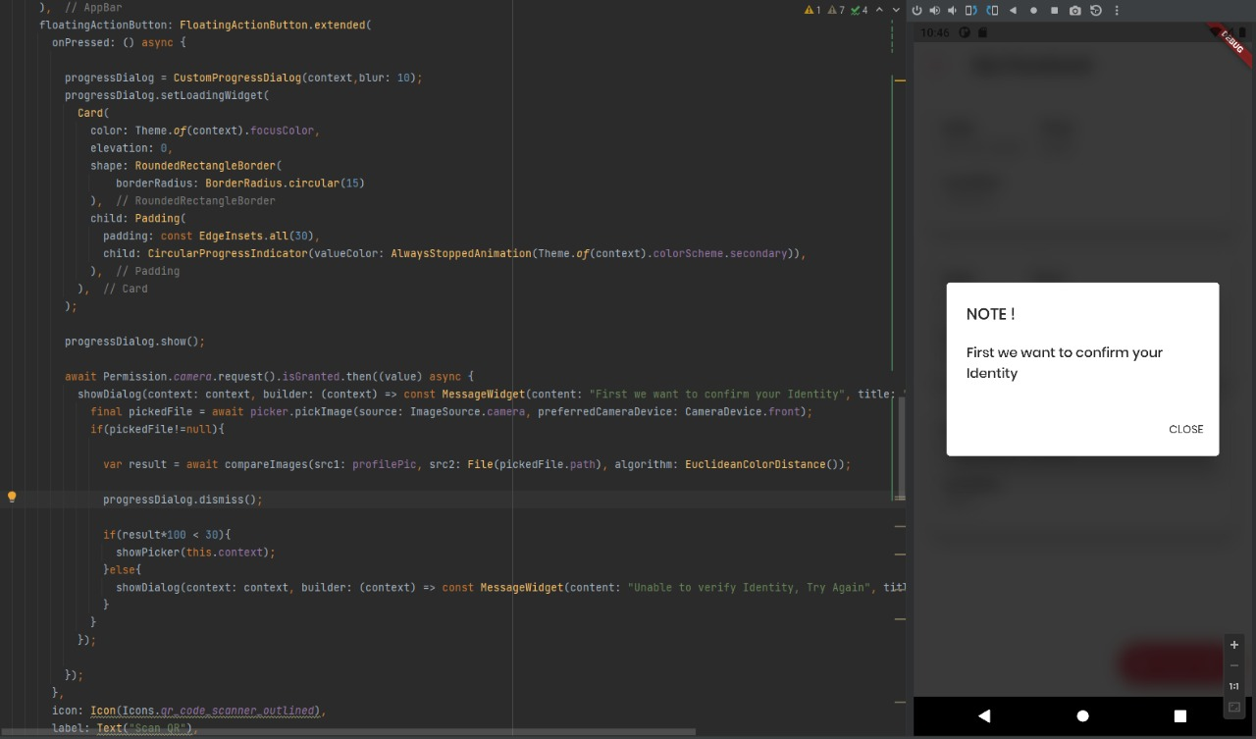
Evidence for the Completion
IT19115108 | Malkanthi.P.L
2022_311

Slide 47
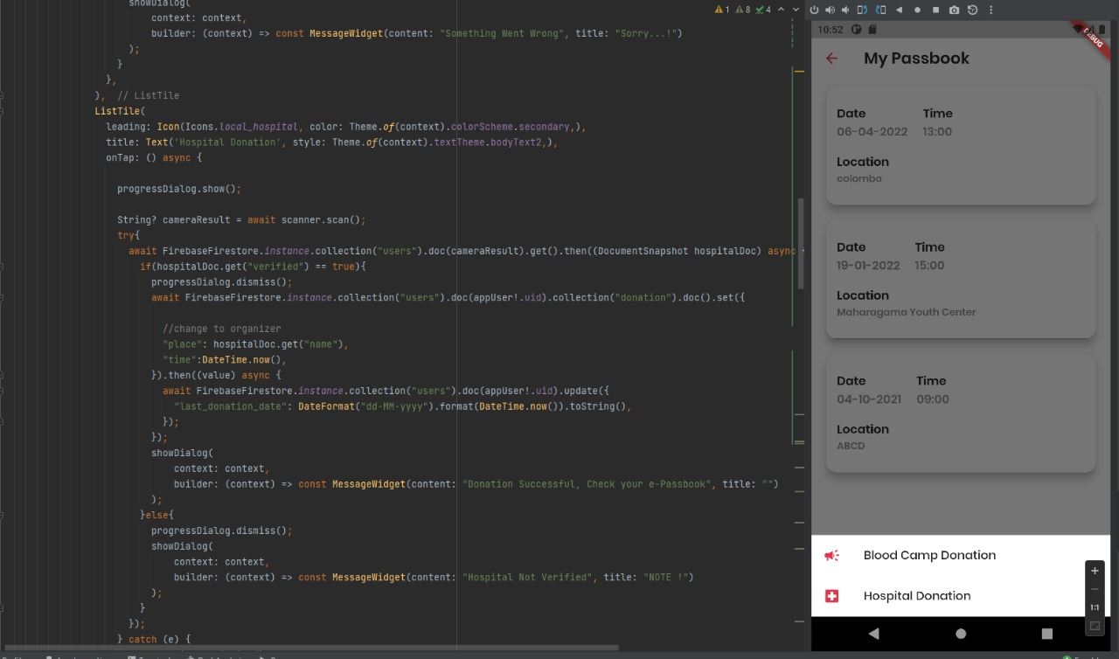
Evidence for the Completion
IT19115108 | Malkanthi.P.L
2022_311

Slide 48
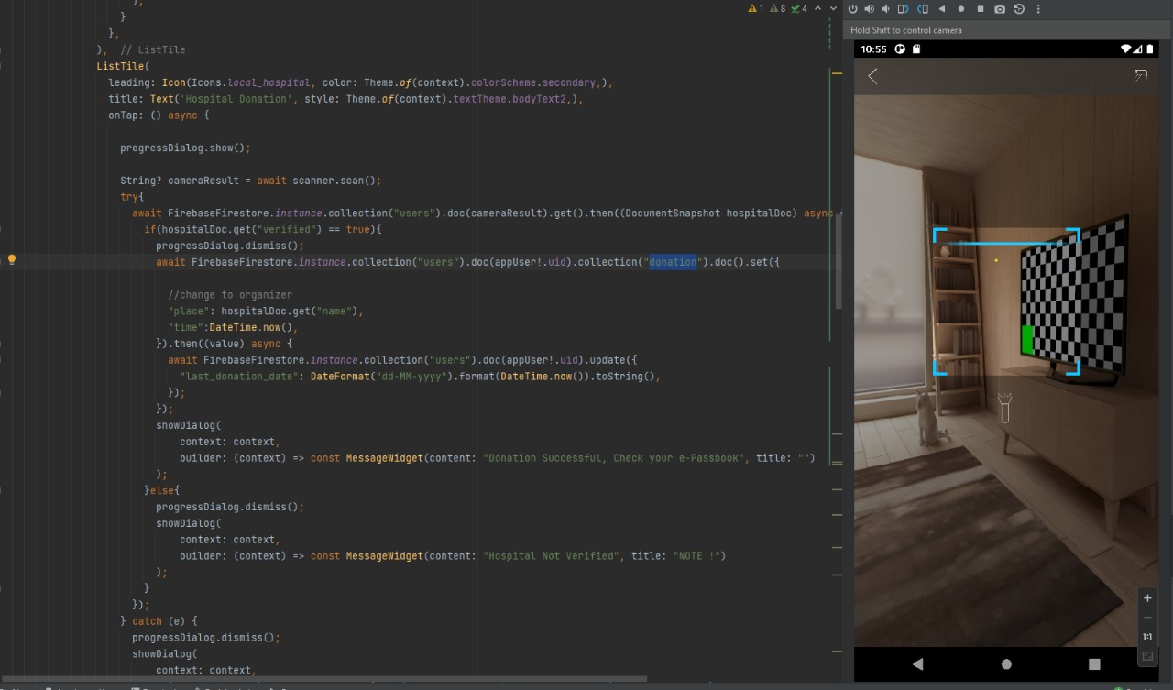
Evidence for the Completion
IT19115108 | Malkanthi.P.L
2022_311

Slide 49
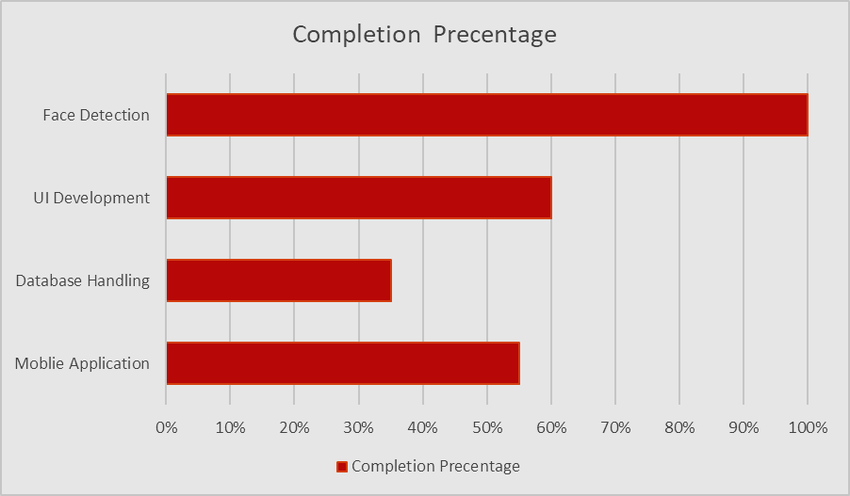
Completion of the project
55%
45%
Completion Of My Sections
Task To Do
IT19115108 | Malkanthi.P.L
2022_311

Slide 50
Technologies
IT19115108 | Malkanthi.P.L
2022_311

Slide 51
References
[1] S. Ouhbi, J. L. Fernández-Alemán, A. Toval, A. Idri, and J. R. Pozo, “Free Blood Donation Mobile Applications,” J. Med. Syst., vol. 39, no. 5, pp. 1–20, 2015, doi: 10.1007/s10916-015-0228-0.
[2]A. A. Batis and A. Albarrak, “Preferences and features of a blood donation smartphone app: A multicenter mixed-methods study in Riyadh, Saudi Arabia,” Comput. Methods Programs Biomed. Updat., vol. 1, no. February, p. 100005, 2021, doi: 10.1016/j.cmpbup.2021.100005.
[3]R. L. Hsu, M. Abdel-Mottaleb, and A. K. Jain, “Face detection in color images,” IEEE Trans. Pattern Anal. Mach. Intell., vol. 24, no. 5, pp. 696–706, 2002, doi: 10.1109/34.1000242.
IT19115108 | Malkanthi.P.L
2022_311

Slide 52
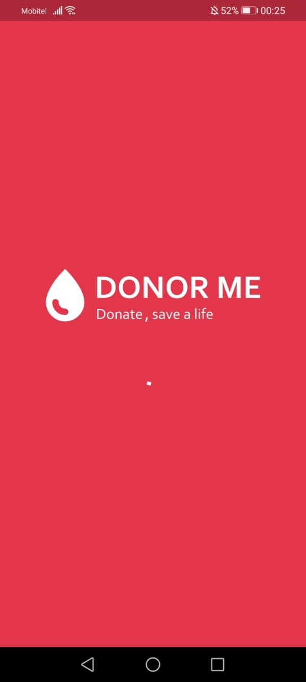
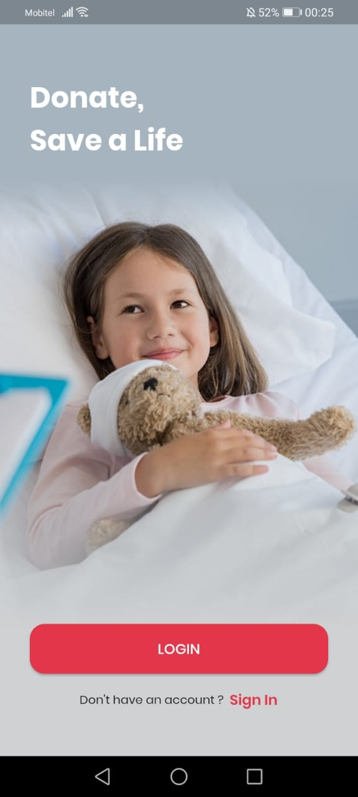
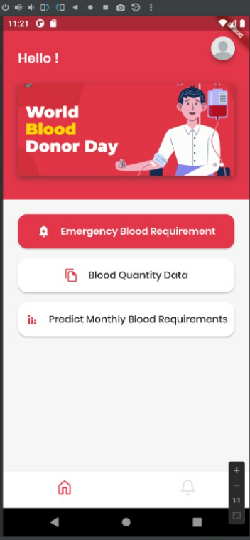
Overall System Achievement

Slide 53
Commercialization
-Basically, this application allows volunteers in the community to donate their tissues and build relationships between the two parties to the process of obtaining those tissues.
-We suggest that this be used as a free mobile application, as it does a social service that goes beyond its monetary worth.

Slide 54
Best Practices
- Created team planner in Microsoft teams
- Designed wireframes
- Git Commit
- Collected data by using google forms

Slide 55
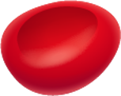
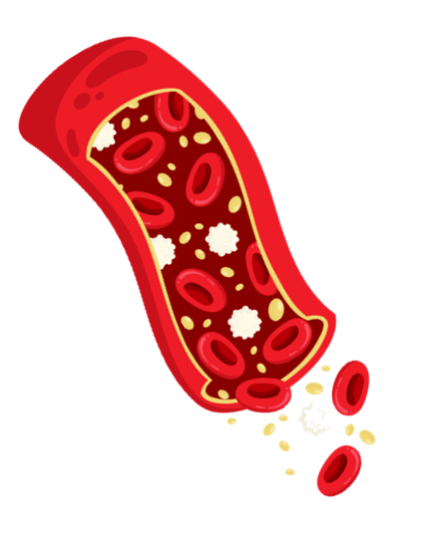

Thank You!

